Slide 1
Open Banking
Defining personal rights and freedoms
in a digital society
Andrew Moor, President and CEO

Slide 2





Wherefore art thou, Canada?
2018
2020
??
UK
Germany
France
Australia
Canada

Slide 3
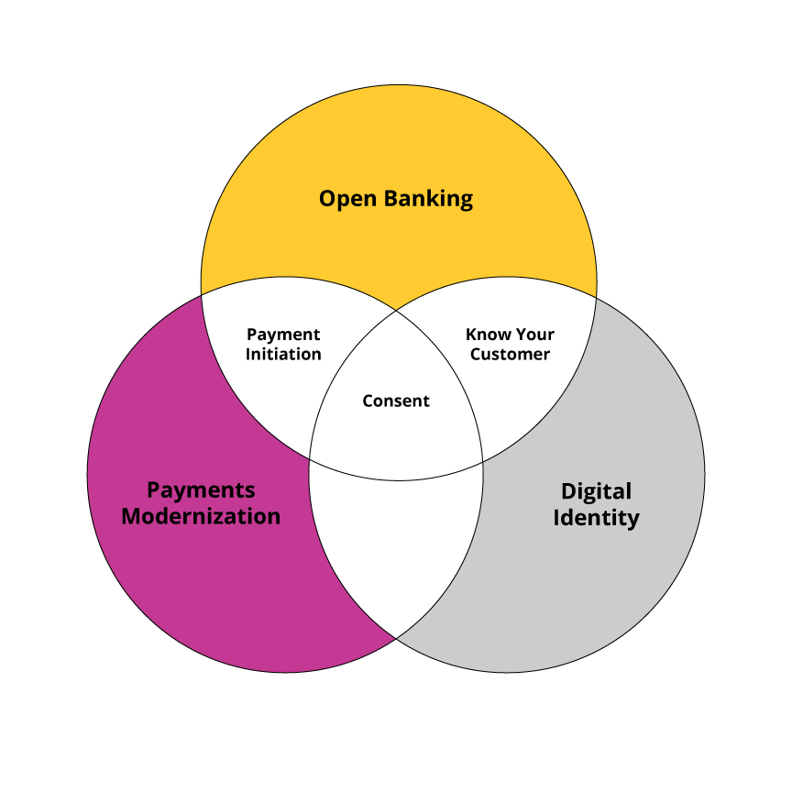
EQ Bank created this diagram five years ago for our submission to the Advisory Committee on Open Banking

Slide 4
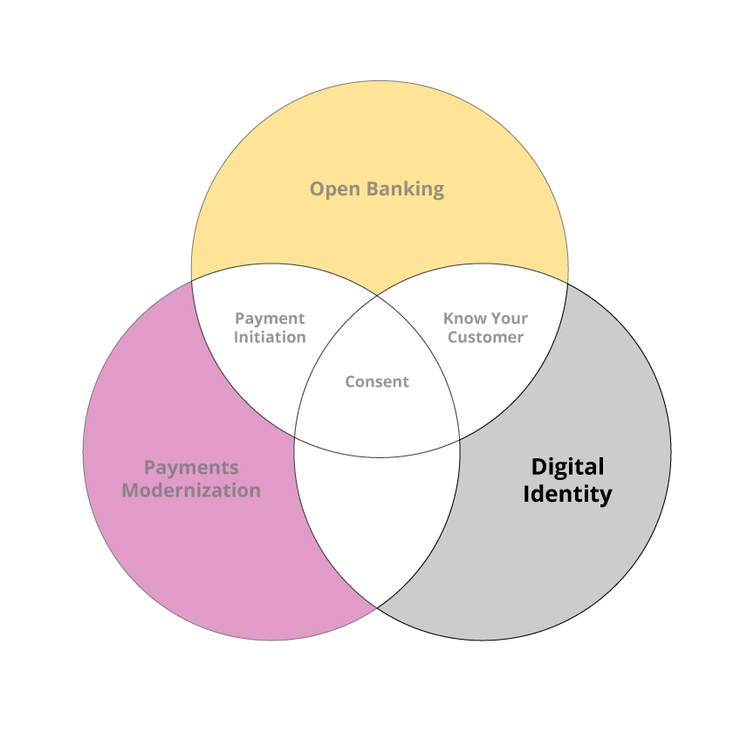
A digital identity could add 1% to GDP, by some estimates, and make all manner of services easier to attain

Slide 5

A central beneficial ownership
registry would support small
business growth and help curb
a reported $113 billion
of annual crime

Slide 6
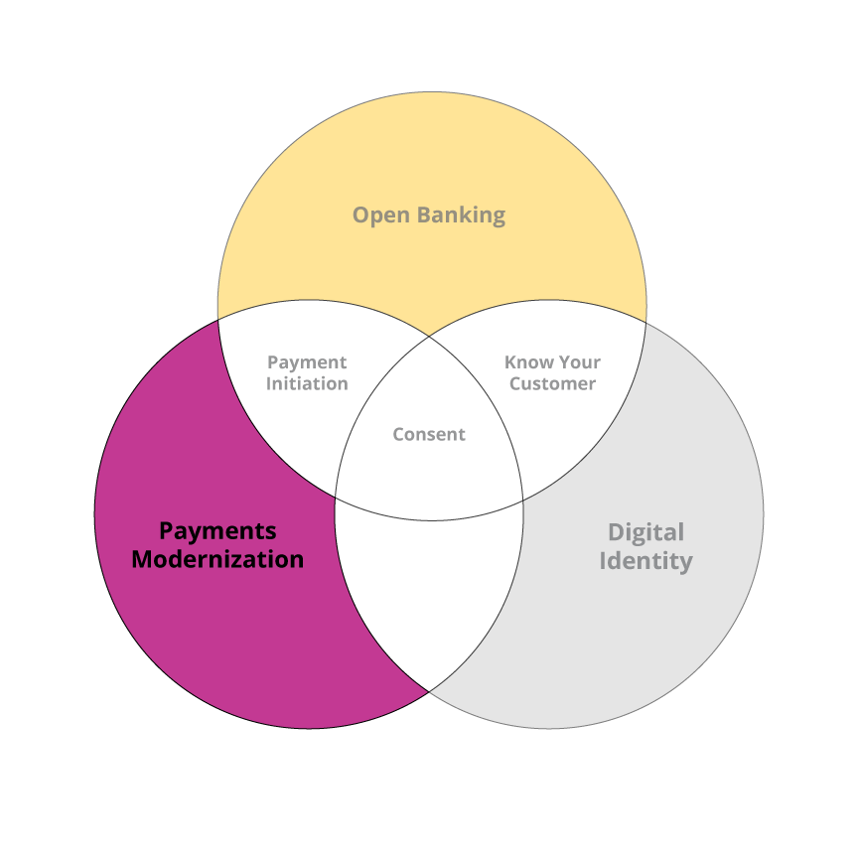
Real-Time Rail is off the rails with no clear prospect of a launch

Slide 7
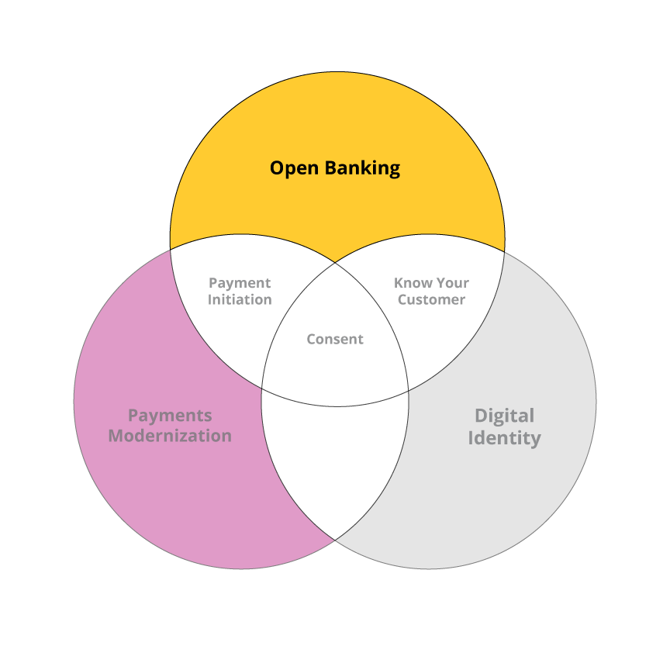
Government accepts the need, yet Canada does not have the means… does it have the will?

Slide 8

Are these really the flags we should be waving?
CHARLIE
FOXTROT

Slide 9

Open Banking for a
Free and Democratic Society

Slide 10
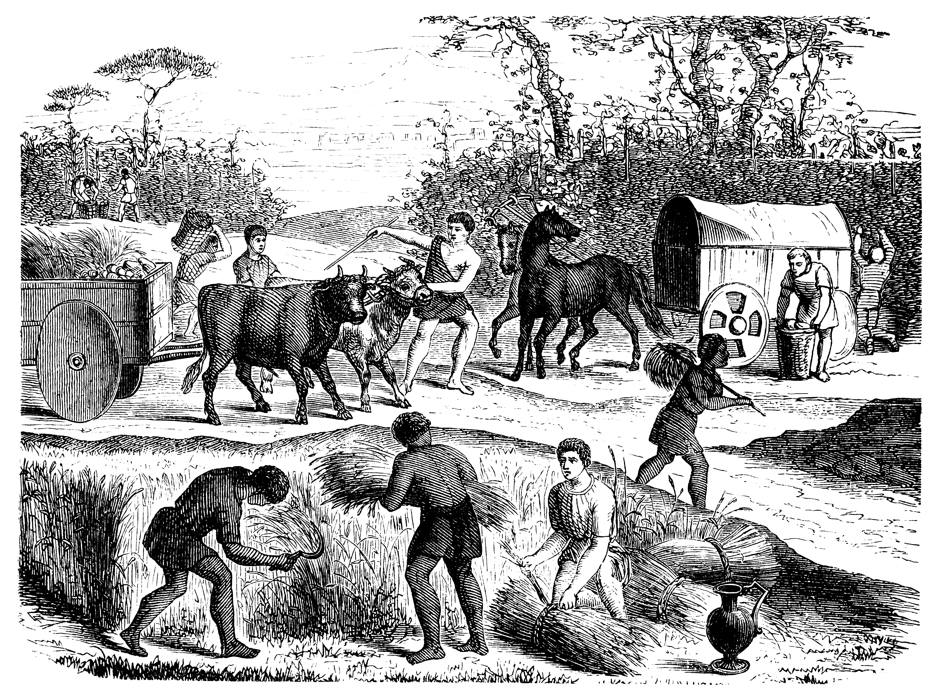
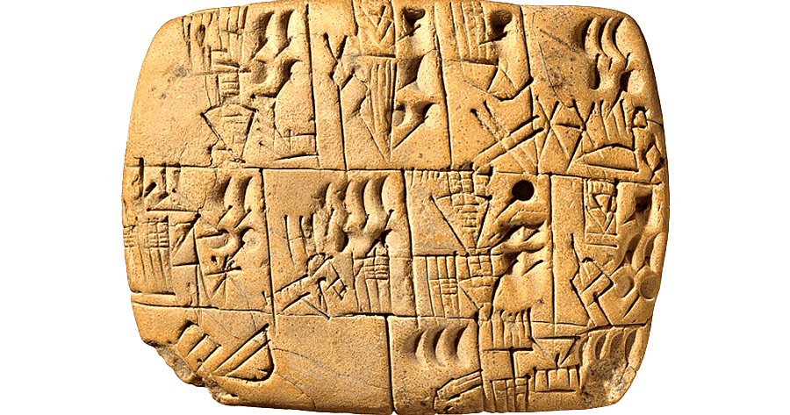
Financial data collection began in ancient Babylonia

Slide 11

Double-entry bookkeeping
allowed the Medicis to dominate
the Renaissance world

Slide 12
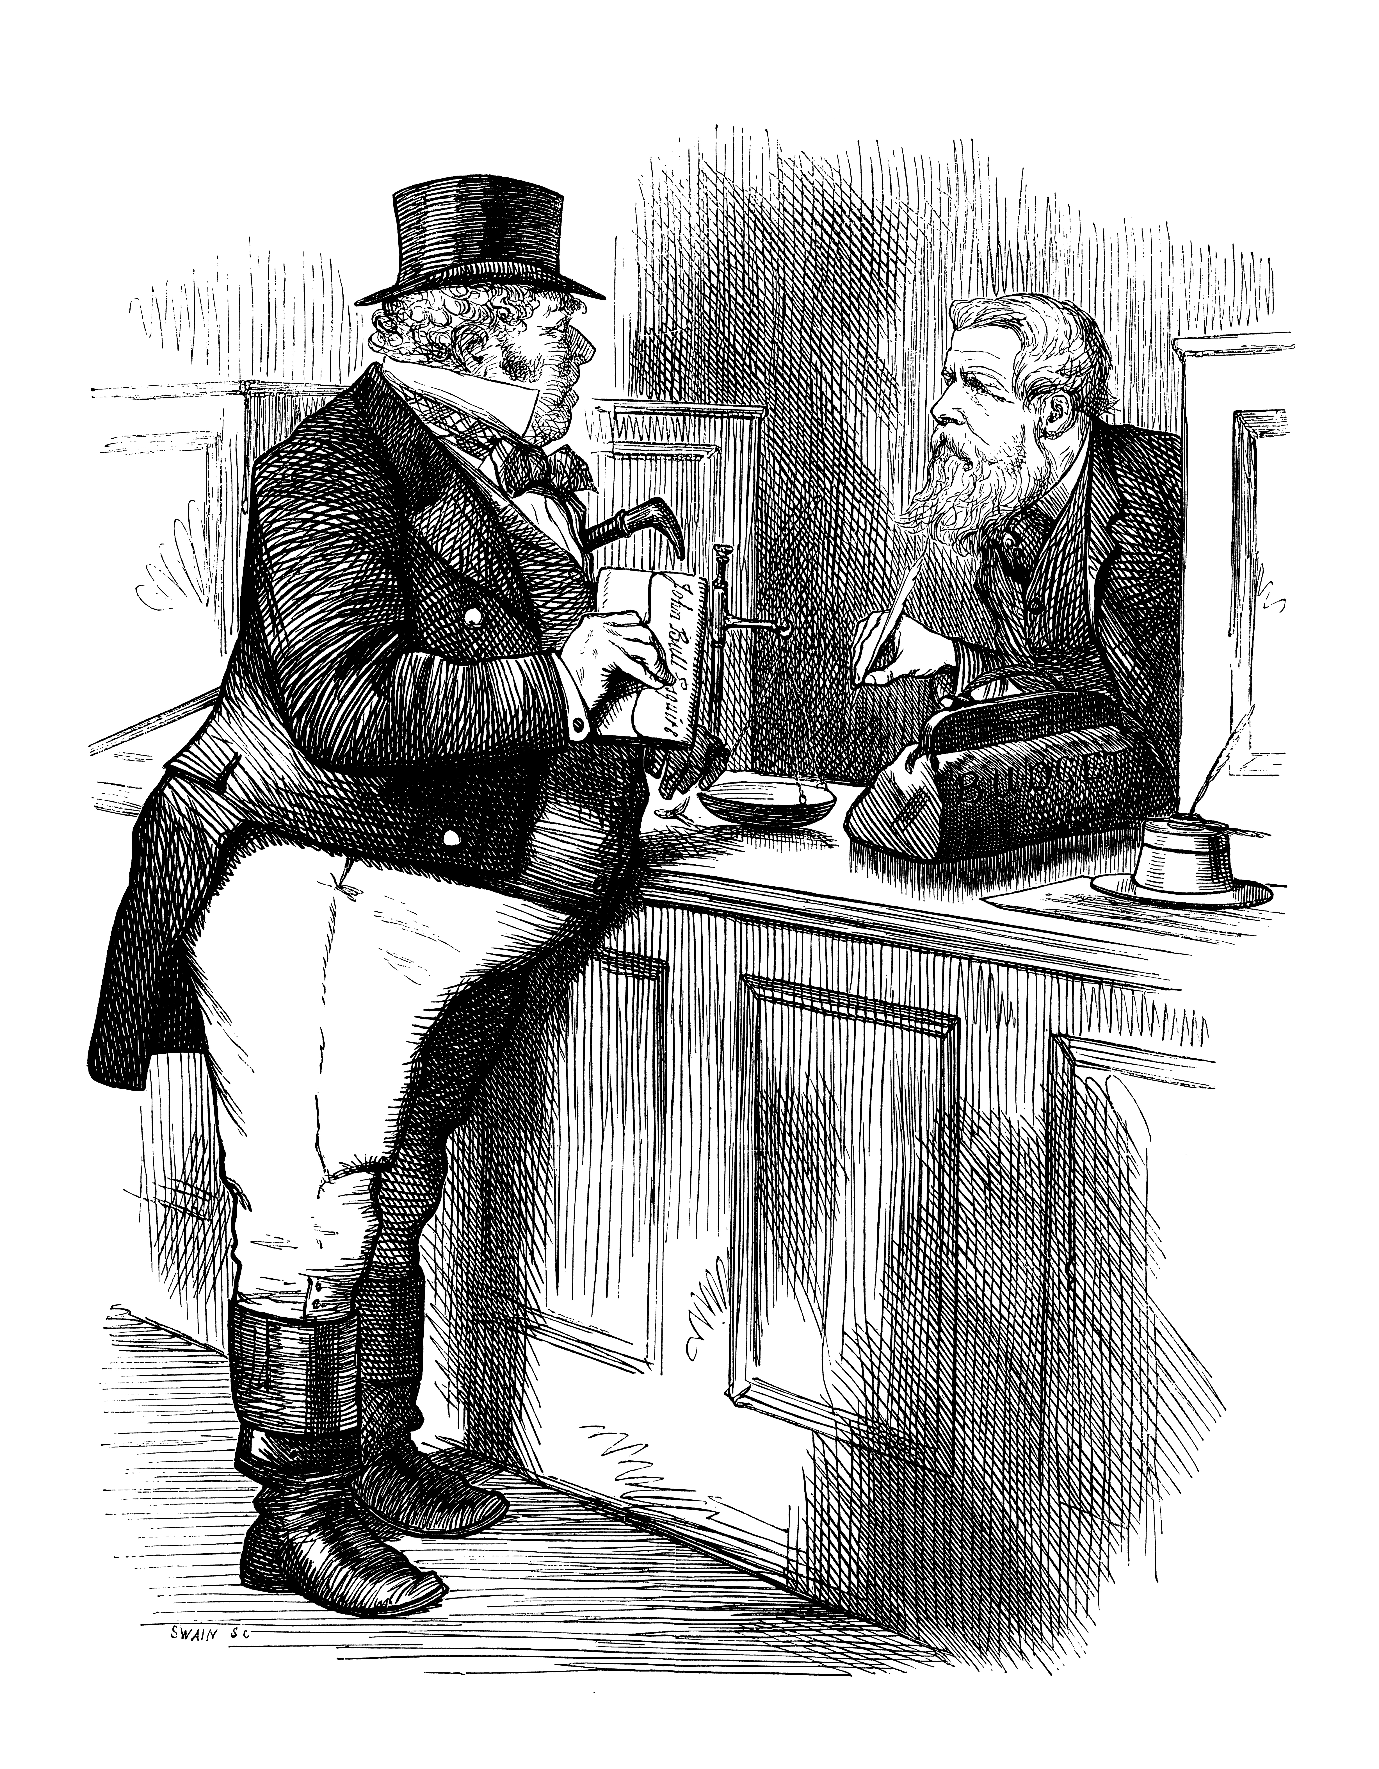
The History of Banks in 1837 chronicled (and bemoaned) monopolistic practices

Slide 13
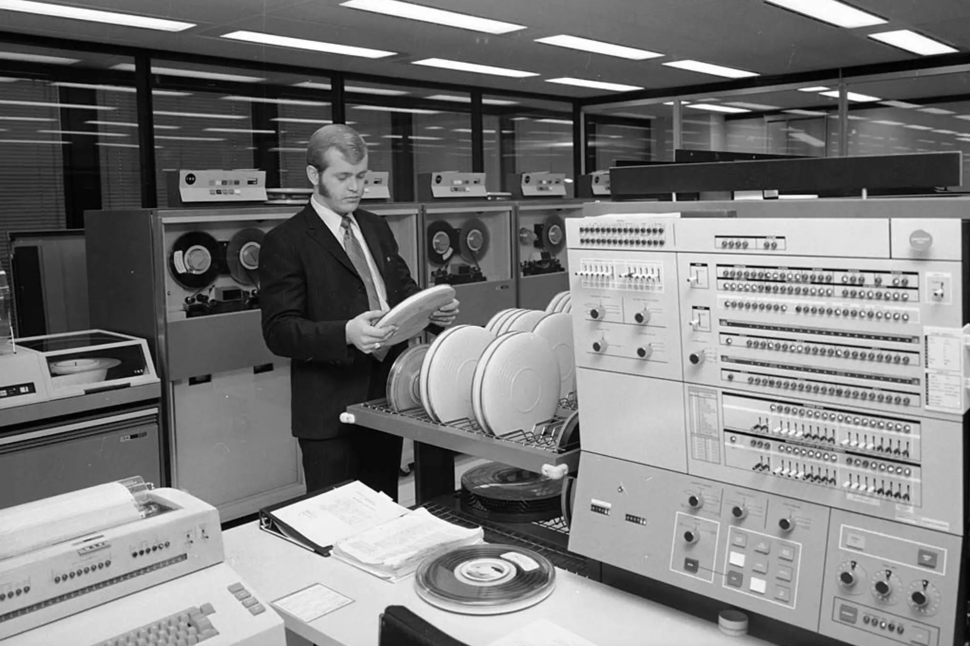
Stanford Research Institute creates World’s first bank mainframe in 1953
City of Toronto Archives (Fonds 1257)

Slide 14
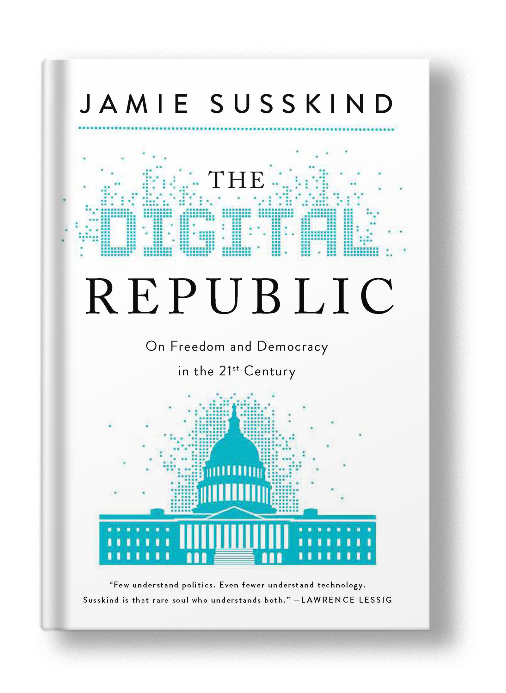
Digital Republicans believe technology should be accountable to the people

Slide 15
“
The problem isn’t Mark Zuckerberg; it’s the idea of Mark Zuckerberg…and all the other Zuckerbergs out there still to come who have the power to make decisions about our collective fate with impunity.
”

Slide 16
The route forward for Canada

Slide 17
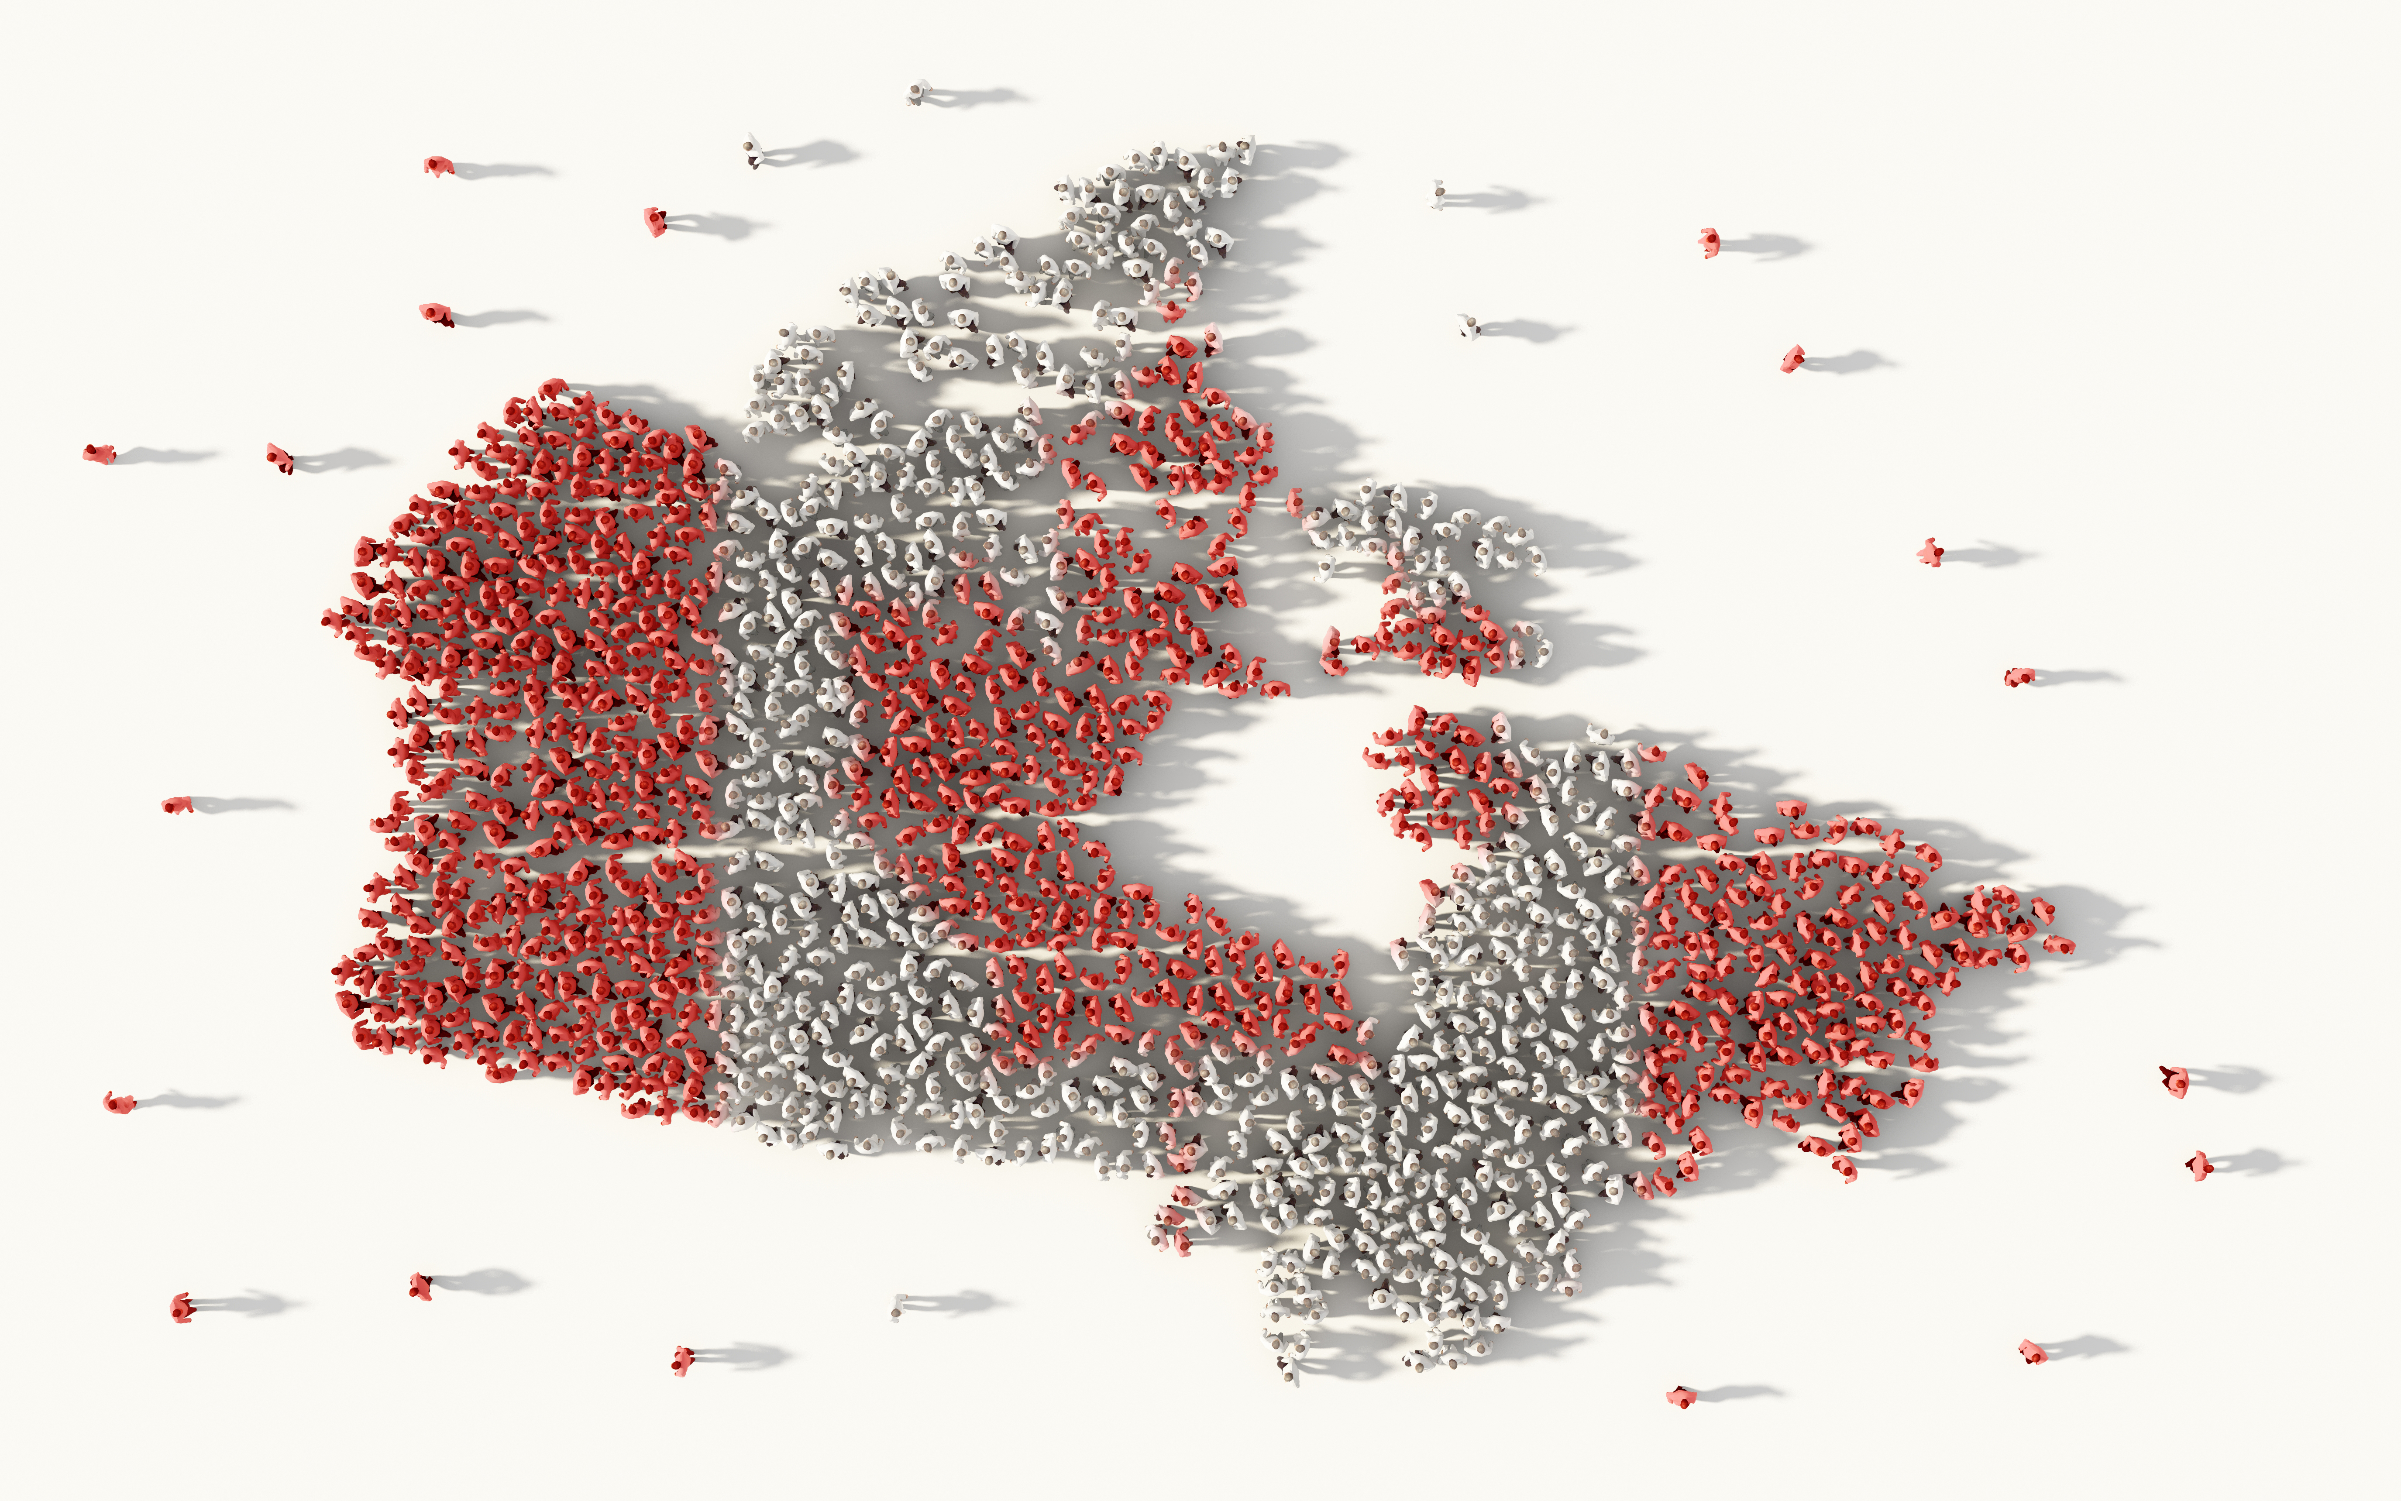
Let’s put the public advantage
at the forefront of our efforts

Slide 18
